Slide 1
Implementation Guide - Ultra-cool curated tweets

Slide 2
Contents
Problem Statement and Requirement
About the system
Functionality

Slide 3
Problem statement
A Client needs us to pull 2 years of ultra-cool curated tweets they have collected and stored themselves.
We need to make sure that we get all tweets from 2016 and 2017.
The only way to get this data is to use the client's REST API. But it's not a well-designed API.

Slide 4
Requirements
Your application should be written in C# or Javascript
Submit your app via a public github repository (make sure we can access it!)
We must be able to build and run your app
The final results should contain all records with no duplicates
The results should be output in a way that allows us to validate your records
The operation should complete in a reasonable amount of time
Your application should make actual calls to our actual pretend REST API (https://badapi.iqvia.io/swagger/) to get the tweets.

Slide 5
About the application
The system fetches the tweet data between year 2016 and 2017.
Data retrieved will be bounded to the UI datatable for user friendly display.
These data can be sorted based on the Id, Date and Text of tweet.
Technology Stack
ASP.Net MVC 4
Jquery Datatable
Bootstrap
Log4Net

Slide 6
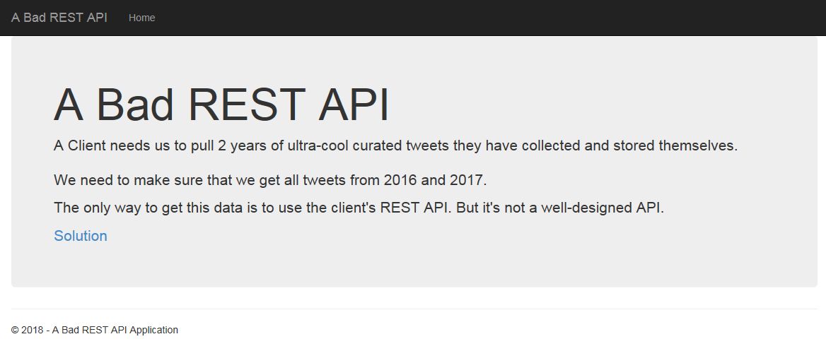
Home Page
Displays the problem statement
Solution click would retrieve the tweets.

Slide 7
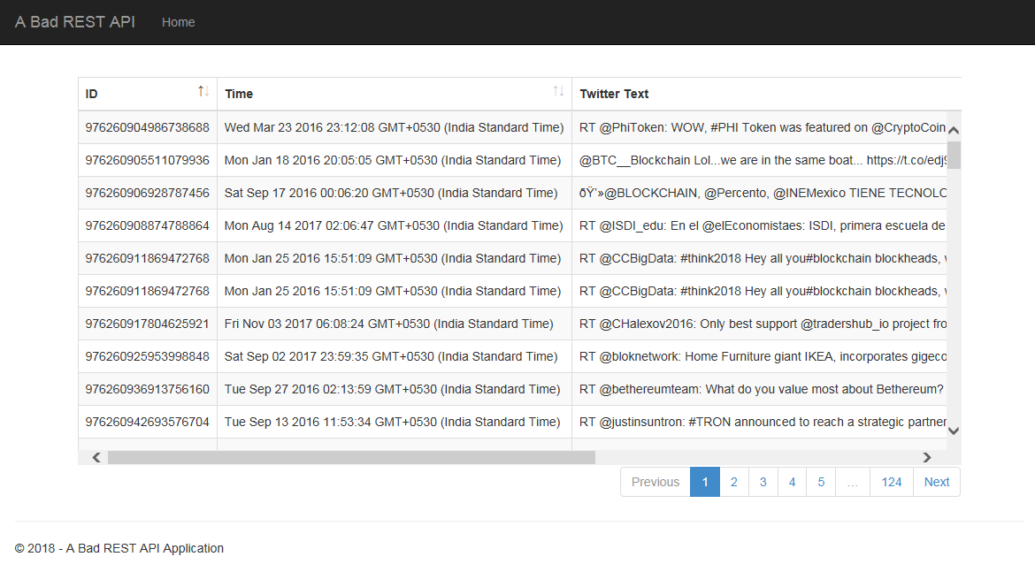
Solution Page
Sorting available
Pagination available to view data in defined number of records

